Slide 1

DEPARTMENT: EEE
PROGRAM: Bachelor Of Technology in Electronics and Telecommunication Technology
MODULE CODE: GENML801
MODULE NAME: machine learning
NAMES: IRADUKUNDA Fabrice
Reg.No: 25RP19327
DATE: 02/10/2025

Slide 2
MOTOR HEALTH PREDICTIVE MAINTENANCE USING MACHINE LEARNING

Slide 3
Define a Problem Statement
According to my project titled” MOTOR HEALTH MONITORING FOR PREDICTIVE MAINTENANCE USING MACHINE LEARNING” Nowadays we still have issue of breakdown motor due to the late or delayed maintenance, small issue that could grow into serious faults and we know that a motor is very important in industry to drive machines, conveyor belt operations and must be maintained well in order to protect it against the risk. So, my project will handle this issue by analyzing data captured by the sensor connected on the motor and compare those received data with the trained model to predict whether a motor needs maintenance or not.

Slide 4
Dataset Description
The dataset of my project consists of sensor readings collected from electric motors operating under both normal and faulty conditions. It includes measurements such as temperature, vibration, rotation and current consumed.
Temperature will indicate the capacity of hotness in degree celicius to ensure if electric motor is operating under or high temperature
Vibration will indicate the internal rotor operation
Current will help us to know if a motor is overloaded of there’s internal problem.

Slide 5
EDA Findings
Univariate Analyses
Analyze each variable at time
Temperature: Values range from 25°C to 95°C, with an average of 55°C. The histogram shows most motors operate around 45–60°C, while faulty motors often exceed 75°C.
Current: Mean current is about 4 A, with stable operation between 3–5 A. Outliers above 6 A are linked to overload or fault conditions

Slide 6
EDA Findings
3. Vibration: Normal operation vibration stays below 0.4 mm/s, but faulty motors show above 1.0 mm/s.
4. RPM: Most motors run steadily at 1450–1500 RPM, with sudden drops observed before some failure events
Bivariate Analyses
Temperature vs Vibration: Scatter plot shows that vibration increases significantly as temperature rises above 70°C.
Temperature vs Current: Higher current often corresponds with higher motor temperature.
Current vs RPM: When the current increases ,rpm decrease

Slide 7
Multivariate Analyses
Temperature, Current, and Vibration Together: Motors with high temperature (>70°C) and high current (>5 A) almost always show high vibration (>1.0 mm/s) which is closer to the fault indication.

Slide 8
Feature engineering steps applied and justification
Handling Missing values
Replaced a small number of missing temperature readings with nearby measurements.
Justification: Maintains a complete dataset for model training without removing too many records.
Feature Creation
Creating of statistical features like precision, F1-score, accuracy and recall.
Justification: These metrics capture motor health behavior with proven useful information in fault diagnosis research.
Scaling and Normalization: Creation of continuous variables
Justification: All features such as current, temperature, and vibration contribute equal role to model training.

Slide 9
Model building and evaluation process
Data loading
First of all I have uploaded file containing all dataset to be used to fulfill my project including: temperature, vibration, current and rotation for model training.
Data splitting
I have divided data into training ,validation and testing sets for the purpose of training model and test how unseen data it is well generalizes.
Model Selection
I have used Logic Regression because it is the one that help me to decide whether a motor needs a maintenance or not by using logic 1 and 0 which indicates yes or no for motor health tracking.

Slide 10
Training the model
The model of this project has been trained using different features such as temperature, vibration, current and rpm to ensure the health of motor and has been adjusted to rise the level of accuracy where the targeted variable was “maintenance is needed or not”.
Metrics Evaluation
Performance was measured using accuracy, precision, recall, and F1-score for the purpose of how well the model identifies both normal and faulty motors, especially when the dataset is imbalanced.
Testing on unseen data
Finally, the model was tested especially by analyzing inserted new data to ensure the motor health and it returns the best result based on dataset adjustment with high accuracy.

Slide 11
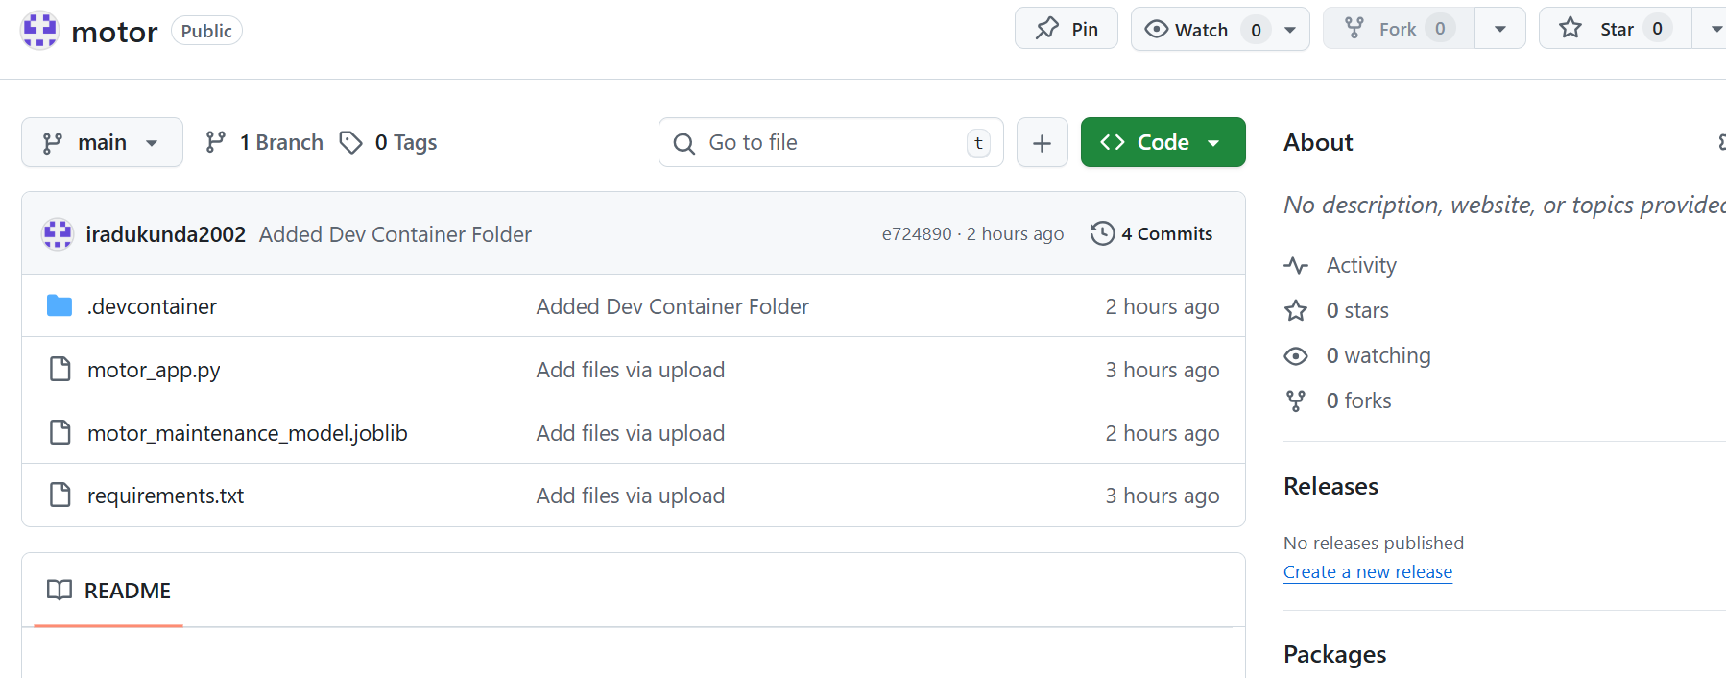
Model Deployment details

Slide 12
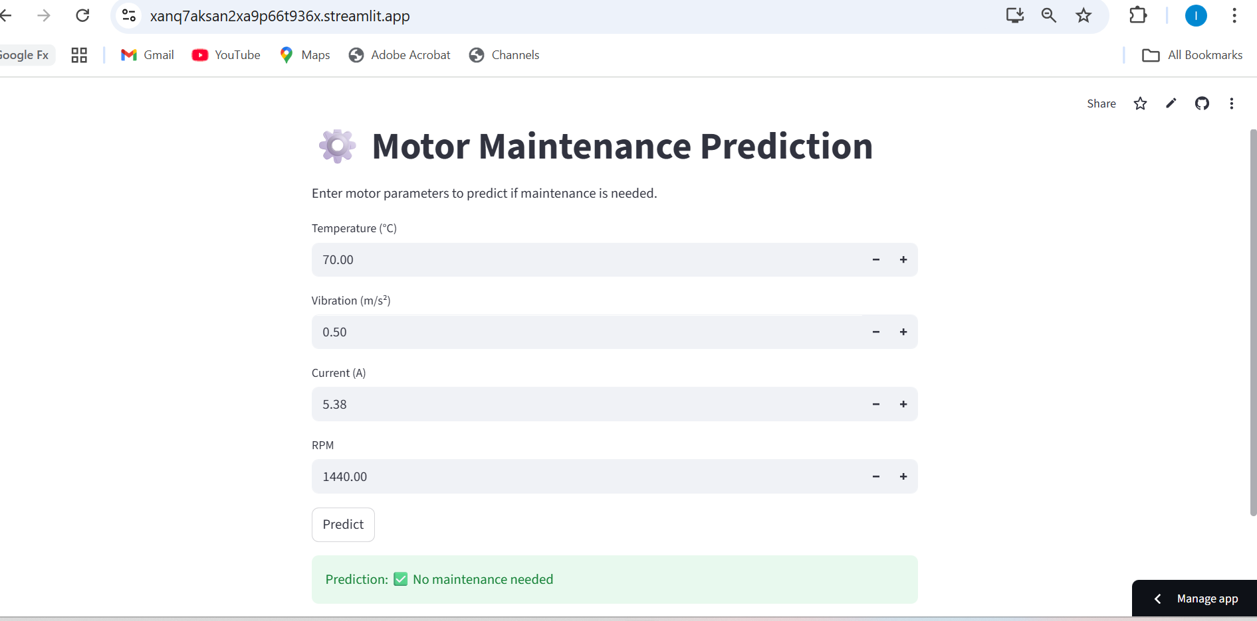

Slide 13
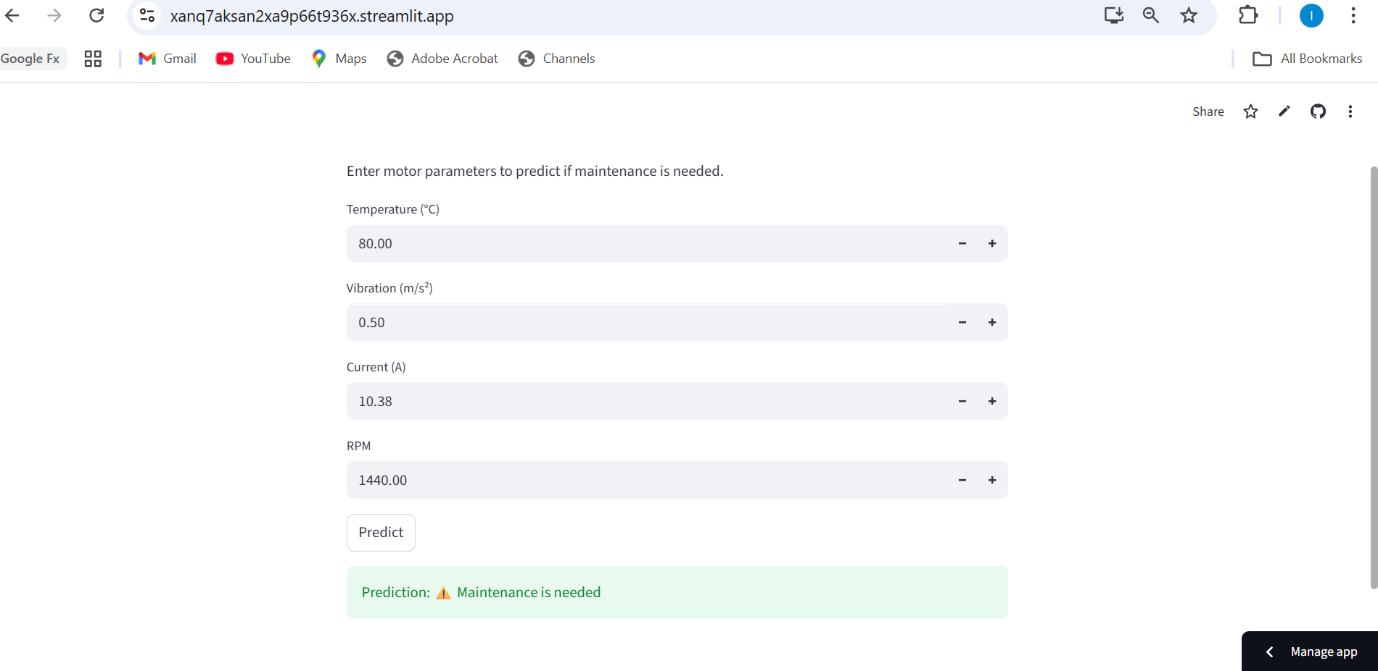

Slide 14
Thank you!

